Slide 1
Introduction to DBMS
DBMS stands for Database Management System. It is a software system that allows users to define, create, manipulate, and manage databases.
It is a structured collection of data organized in a way that allows for efficient storage, retrieval, and manipulation of information.
DBMS is a suit of computer software providing interface between user’s and database.
Some of the famous DBMS System we are currently using are:-
MySQL
Oracle Database
MongoDB and many more.

Slide 2
Advantages of using DBMS
Faster data Access
Better decision making
Increased end-user productivity
Easy to use
Scalability and flexibility
Efficient data access and retrieval
Improved productivity

Slide 3
Introduction to SQL
SQL stands for Structured Query Language
SQL was developed in the 1970s by IBM Computer Scientists and became a standard of the International Organization for Standardization (ISO) in 1987.
SQL is a standard language for storing, manipulating and retrieving data in databases.
It includes Database Creation, Database Deletion, Fetching Data Rows, Modifying & Deleting Data rows, etc.
It is one of the easiest way to access data in the relational database management systems.

Slide 4
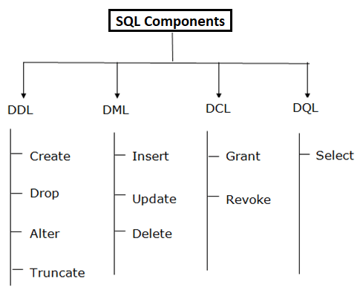
Components of SQL

Slide 5
Data Definition Language
DDL changes the structure of the table like creating a table, deleting a table, altering a table, etc.
All command of DDL are auto-committed i.e., it permanently save all the changes in the database.
Below are some commands that come under DDL:
CREATE
ALTER
DROP
TRUNCATE

Slide 6
Data Manipulation Language
DML commands are used to modify the database. It is responsible for all form of changes in the database. structure
The command of DML is not auto-committed that means it can't permanently save all the changes in the database. They can be rollback.
Below are some commands that come under DML:
INSERT
UPDATE
DELETE

Slide 7
Data Query Language
DQL is used to fetch the data from the database.
DQL uses only one command.
SELECT

Slide 8
Data Control Language
DCL commands are used to grant and take back authority from any database user.
Below are some commands that come under DCL:
Grant
Revoke

Slide 9
SQL Syntax
CREATE DATABASE databasename;
CREATE DATABASE checkdb;
DROP DATABASE databasename;
DROP DATABASE checkdb
USE checkdb;
CREATE TABLE table_name (column1 datatype,column2 datatype);
CREATE TABLE Persons (PersonID int, Name varchar(255), City varchar(255));
DESC checkdb

Slide 10
CREATING TABLE FROM EXESTING TABLE
CREATE TABLE new_table_name AS SELECT column1, column2,... FROM existing_table_name
CREATE TABLE TestTable AS SELECT customername, contactname FROM customers;
DROP TABLE table_name;
DROP TABLE TestTable
TRUNCATE TABLE table_name;
TRUNCATE TABLE TestTable
NOTE:- Here difference between drop and truncate is using drop we are deleting table as well as data in the table whereas using truncate we are just deleting the data inside the table but not the table.

Slide 11
CRUD OPERATIONS
CRUD= CREATE, READ, UPDATE and DELETE
CREATE
Create means to add or insert data into the SQL table.
CREATE TABLE table_name (column1 datatype,column2 datatype);
CREATE TABLE Persons (PersonID int PRIMARY key, Name varchar(255), City varchar(255));
INSERT INTO Table_Name (ColumnName1,...., ColumnNameN) VALUES (Value 1,....,Value N),....
INSERT INTO Customers (CustomerName, ContactName, Address, City, PostalCode, Country) VALUES ('Cardinal', 'Tom B.Erichsen', 'Skagen 21', 'Stavanger', '4006', 'Norway');

Slide 12
We can insert insert data in specific columns
INSERT INTO Customers (CustomerName, City, Country) VALUES ('Cardinal', 'Stavanger', 'Norway’);
READ
Read means to fetching the data from the SQL table
SELECT *FROM TableName;
select * from Customers
To fetch records using condition
SELECT *FROM TableName WHERE CONDITION;
SELECT *FROM employee WHERE Salary > 35000;
SELECT *FROM employee WHERE Salary =“35000”;

Slide 13
UPDATE
Update means to update the records precent in SQL Tables.
UPDATE Table_Name SET ColumnName = Value WHERE CONDITION;
UPDATE employee SET Last_Name = "Bose" WHERE ID = 6;
UPDATE employee SET Salary = "35000", Email_Id=
"shwetawagh03@gmail.com" WHERE ID = 10;

Slide 14
DELETE
Delete means removing or deleting the records from the SQL tables
To Delete all the records
DELETE FROM TableName;
DELETE FROM employee;
To Delete the records using conditions
DELETE FROM TableName WHERE CONDITION;
DELETE FROM employee WHERE Salary = 34000;

Slide 15
SQL JOIN
JOINS are used to combine rows from two or more tables, based on a related column between them.
THERE ARE 4 TYPES OF JOINS
INNER JOIN
LEFT JOIN
RIGHT JOIN
FULL JOIN

Slide 16
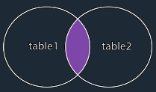
INNER JOIN
It selects records that have matching values in both tables.
SYNTAX
SELECT column_name(s) FROM table1 INNER JOIN table2 ON table1.column_name = table2.column_name;

Slide 17
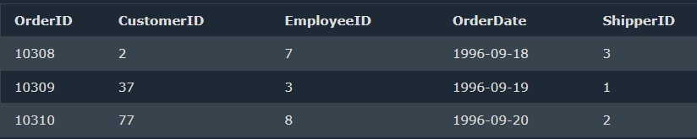
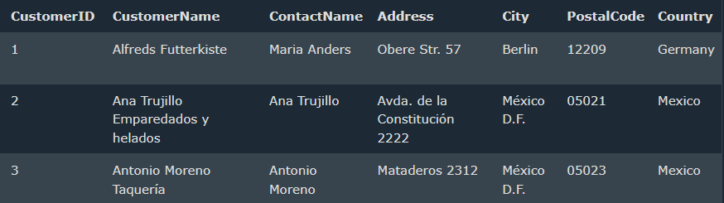

Orders
Customers
SELECT Orders.OrderID, Customers.CustomerName FROM Orders INNER JOIN Customers ON Orders.CustomerID = Customers.CustomerID;
Result =

Slide 18
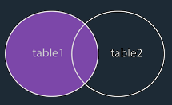
Left JOIN
It returns all records from the left table i.e., table1 and the matching records from the right table i.e., table2. The result is 0 records from the right side, if there is no match.
SYNTAX
SELECT columns FROM table1
LEFT JOIN table2 ON
table1.column_name = table2.column_name;

Slide 19
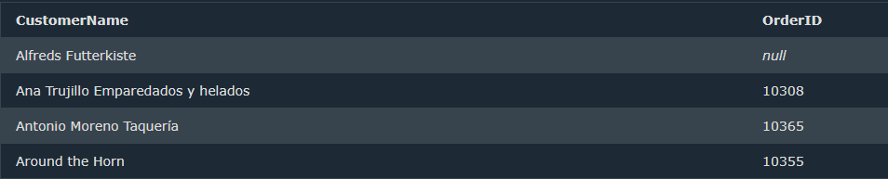
Customers
Orders
SELECT Customers.CustomerName, Orders.OrderID FROM Customers LEFT JOIN Orders ON Customers.CustomerID = Orders.CustomerID ORDER BY Customers.CustomerName;
Result =

Slide 20
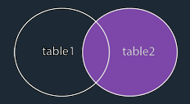
Right JOIN
It returns all records from the right table i.e., table2 and the matching records from the left table i.e., table1. The result is 0 records from the left side, if there is no match.
SYNTAX
SELECT column_name(s) FROM table1 RIGHT JOIN table2 ON table1.column_name = table2.column_name;

Slide 21
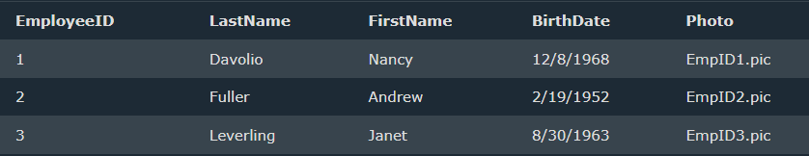
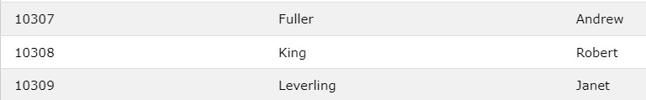
Orders
Employees
SELECT Orders.OrderID, Employees.LastName, Employees.FirstName FROM Orders RIGHT JOIN Employees ON Orders.EmployeeID = Employees.EmployeeID ORDER BY Orders.OrderID;
Result =

Slide 22
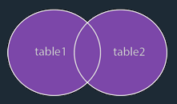
FULL JOIN
It returns all records when there is a match in Table 1 or Table 2 records.
SYNTAX
SELECT column_name(s) FROM table1 FULL OUTER JOIN table2 ON table1.column_name = table2.column_name WHERE condition;

Slide 23
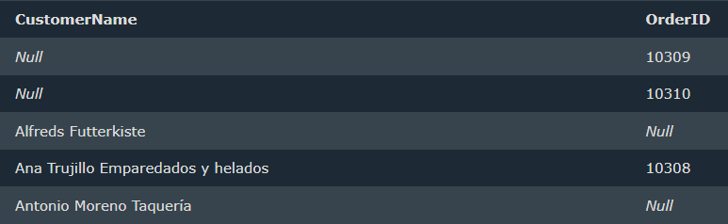
Customers
Orders
SELECT Customers.CustomerName, Orders.OrderID FROM Customers FULL OUTER JOIN Orders ON Customers.CustomerID=Orders.CustomerID ORDER BY Customers.CustomerName;
Result =

Slide 24
GROUP BY
GROUP BY clause is used to group rows from a table based on the values in one or more columns.
It is often used in conjunction with aggregate functions to perform calculations on the grouped data.
Aggregate functions are
SUM()
COUNT()
AVG()
MAX()
MIN()

Slide 25
SYNTAX
SELECT column1, aggregate_function(column2)
FROM table_name
GROUP BY column1;
CREATING Table and Inserting Data
CREATE TABLE sales ( order_id INT PRIMARY KEY, product_id INT, quantity INT, price DECIMAL(10, 2), customer_id INT, order_date DATE );
INSERT INTO sales (order_id, product_id, quantity, price, customer_id, order_date) VALUES (1, 101, 5, 11.99, 1, '2023-01-15'), (2, 102, 3, 8.49, 2, '2023-01-16'), (3, 101, 2, 10.99, 3, '2023-01-16'), (4, 103, 1, 15.99, 2, '2023-01-17'), (5, 101, 4, 10.99, 4, '2023-01-18'), (6, 102, 2, 12.49, 5, '2023-01-19'), (7, 104, 3, 12.99, 3, '2023-01-20'), (8, 103, 5, 18.99, 6, '2023-01-20'), (9, 101, 2, 12.99, 4, '2023-01-21'), (10, 102, 3, 8.49, 7, '2023-01-21');

Slide 26

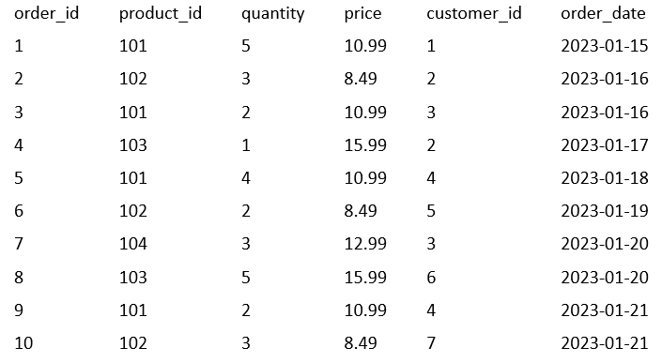
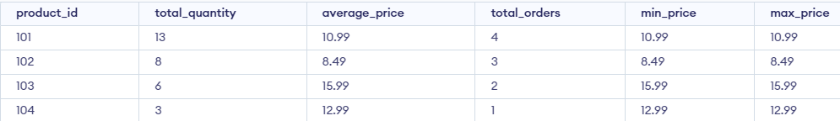
SELECT product_id, SUM(quantity) AS total_quantity,
AVG(price) AS average_price,
COUNT(*) AS total_orders,
MIN(price) AS min_price,
MAX(price) AS max_price
FROM sales
GROUP BY product_id;

Slide 27
SUBQUERIES
Subquery are also known as a nested query or inner query.
Subqueries are used to retrieve data from one or more tables and then use that result set as a condition or criteria for another query.
Subqueries are a powerful tool in SQL, allowing you to perform complex data retrieval and manipulation tasks.
SYNTAX:-
SELECT column1, column2, ...
FROM table1
WHERE columnN operator (SELECT columnX FROM tableY
WHERE condition);

Slide 28
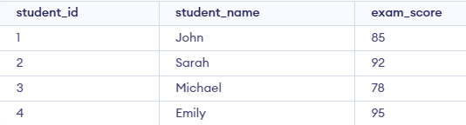

R
CREATE TABLE students (
student_id INT PRIMARY KEY,
student_name VARCHAR(50),
exam_score INT );
INSERT INTO students
VALUES
(1, 'John',85),
(2, 'Sarah',92),
(3, 'Michael',78),
(4, 'Emily',95);
SELECT student_name, exam_score FROM students
WHERE exam_score > (SELECT AVG(exam_score) FROM students);
Result =

Slide 29
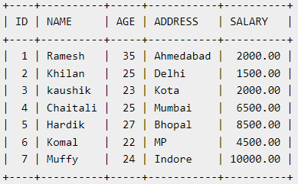
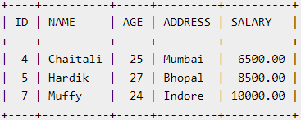
EG2-
SELECT * FROM CUSTOMERS WHERE ID IN (SELECT ID FROM CUSTOMERS WHERE SALARY > 4500) ;

Slide 30
INDEXING
Indexing is a database optimization technique used in SQL to improve the performance of queries.
An index is a data structure that provides fast access to rows in a table based on the values in one or more columns (Increase speed).
By creating indexes on specific columns, you can significantly speed up the retrieval of data.
Without indexes, the database management system would need to perform full table scans, which can be slow and resource-intensive, especially on large tables

Slide 31
SYNTAX:-
CREATE INDEX index_name
ON table_name (column_name);
To create on multiple column
CREATE INDEX index_name
ON table_name (column1, column2);
Here the query and everything will be same but after creating the index on particular column its easy for database to fetch the record from particular column
SELECT * FROM table_name WHERE CONDITION
SHOW INDEX FROM your_table_name;
DROP INDEX index_name ON table_name;
ALTER TABLE table_name DROP INDEX index_name;

Slide 32
KEYS IN SQL
PRIMARY KEY
Primary key uniquely identifies each row in a table.
Unique Key
Set of one or more fields that identifies records in the table.
Same as that of primary key just that there can be null values but no duplicates are allowed.
CREATE TABLE Products (ProductID INT UNIQUE, ProductName VARCHAR(100),
Price DECIMAL(10, 2));

Slide 33
FOREIGN KEY
It Is a field in one table that refers the primary key in another table.
Table with foreign key is called as child table and table with parent key is called as parent table.
CREATE TABLE Orders ( OrderID INT PRIMARY KEY, CustomerID INT,
OrderDate DATE, FOREIGN KEY (CustomerID) REFERENCES Customers(CustomerID) );
COMPOSITE KEY
This key is combination of more than one field or column
CREATE TABLE StudentCourses ( StudentID INT, CourseID INT, PRIMARY KEY (StudentID, CourseID) ;
CANDIDATE KEY
A key which is candidate of primary key is nothing but candidate key.

Slide 34
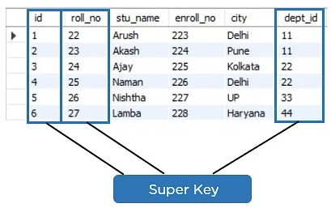
SUPER KEY
It is a set of one or more columns (attributes) within a table that can be used to uniquely identify rows in that table.
The Primary Key is a subset of Super Key. So, we can say every primary key is super key

Slide 35
NORMALIZATION
Normalization is the process of organizing the data in the database.
Normalization divides the larger table into smaller and links them using relationships.
The process of normalization typically involves breaking down a large table into smaller, related tables and defining relationships between them using keys (usually primary and foreign keys). This reduces data duplication and ensures that each piece of data is stored in only one place
Why NORMALIZATION?
Helps to minimize data redundancy
Database organization
Much more flexible database design

Slide 36
Normalization are of 4 types
First Normal Form (1NF)
Second Normal Form (2NF)
Third Normal Form (3NF)
Boyce-Codd Normal Form (BCNF)

Slide 37
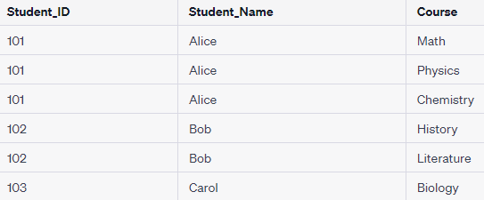
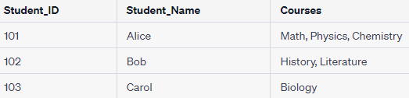
First Normal Form (1NF)
Eliminates duplicate columns within a table.
Ensures that each column contains indivisible values.
Allows for the easy addition of new rows without changing the table structure.
Here column courses have multiple values. This is not in 1NF because it violates the rule that each column should contain indivisible values.

Slide 38
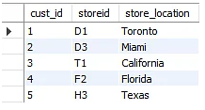
Second Normal Form (2NF)
Builds on 1NF.
Ensures that each non-key column is fully functionally dependent on the entire primary key.
Involves splitting tables to achieve this if necessary.
The table possesses a composite primary key cust_id, storeid. The non-key attribute is store_location. In this case, store_location only depends on storeid, which is a part of the primary key. Hence, this table does not fulfill the second normal form.

Slide 39
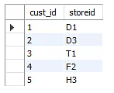
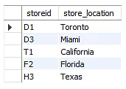
Now to convert the table in 2 NF we need to split the table
As we removed the partial functional dependency from the location table, the column store_location entirely depends on the primary key of that table, storeid.

Slide 40
Third Normal Form (3NF)
Builds on 2NF.
Ensures that there is no transitive dependency between non-key columns.
Non-key columns should only depend on the primary key directly.
Transitive Dependency:- When one column depends on a column which is not a primary key.
Let suppose A -→ B. Here A and B both are not a primary key i.e we can say they are non-prime attribute. So here A can contains null value as it is non-prime attribute and if B is fully dependent on non-prime A then issue arries. Thus Transitive Dependency should be removed.

Slide 41


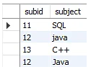
In this table the column stu_id is primary key else all the column are non-prime.
Here we could see that the column sub is fully dependent on column subid. Thus, we can say that transitive dependency Is present in the above table.
Now we can say that the table is in 3NF as both tables are now fully functional, dependent only on the primary key.
In first table all column are fully depends on stu_id.
In second table subject is depends on subid and subid is fully depends on stu_id.

Slide 42
Boyce-Codd Normal Form (BCNF)
Boyce Codd Normal Form is also known as 3.5 NF
Certain types of anomalies which were not resolved with 3NF thus BCNF was introduce.
Table should be in 3NF.
Every Right-Hand Side (RHS) attribute of the functional dependencies should depend on the super key of that particular table.

Slide 43
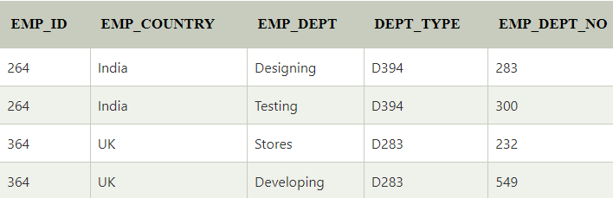
From the table Functional dependencies are
EMP_ID → EMP_COUNTRY
EMP_DEPT → {DEPT_TYPE, EMP_DEPT_NO}
This Candidate key={ EMP_ID , EMP_DEPT }
The table is not BCNF as both EMP_ID and EMP_DEPT are not super key

Slide 44
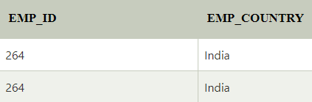
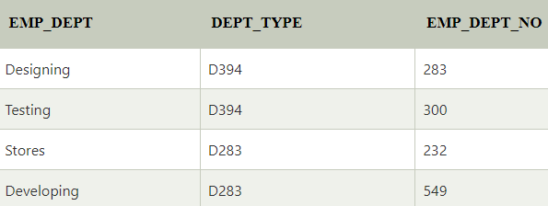
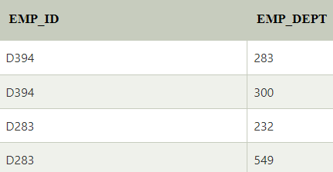
EMP_ID → EMP_COUNTRY
EMP_DEPT → {DEPT_TYPE, EMP_DEPT_NO}
Candidate keys:
For 1st table: EMP_ID For 2nd table: EMP_DEPT For 3rd table: {EMP_ID, EMP_DEPT}

Slide 45
VIEWS
View is a virtual table based on the result-set of an SQL statement.
A view contains rows and columns, just like a real table. The fields in a view are fields from one or more real tables in the database.
SYNTAX:-
CREATE VIEW view_name AS
SELECT column1, column2, ...
FROM table_name
WHERE condition;

Slide 46
To create View the table should be already created.
CREATE TABLE students (
student_id INT PRIMARY KEY,
student_name VARCHAR(50),
exam_score INT );
INSERT INTO students
VALUES
(1, 'John',85),
(2, 'Sarah',92),
(3, 'Michael',78),
(4, 'Emily',95);
create view view_students AS select student_id, student_name from students
DELETE FROM view_students WHERE student_name = ‘John';
UPDATE view_students SET exam_score = exam_score + 500 WHERE student_name = ‘Sarah';
To view the view
select * from view_students

Slide 47
ACID PROPERTIES
ACID stands for Atomicity, Consistency, Isolation, and Durability.
They are used to maintain consistency in a database, before and after the transaction for which certain properties need to be followed.
We can also say that they are fundamental principles that ensure data integrity(Data Accuracy, Consistency).
Maintaining the ACID properties is crucial for ensuring the integrity and reliability of database systems, especially in mission-critical applications such as financial systems, e-commerce platforms, and healthcare databases.

Slide 48
ATOMICITY
Atomicity ensures that a transaction is treated as a single, indivisible unit of work
It means that either all the changes made by a transaction are successfully applied to the database, or none of them are.
If any part of a transaction fails (e.g., due to a system crash or error), the entire transaction is rolled back, and the database remains unchanged.
Suppose a bank transfer involves debiting one account and crediting another. Atomicity ensures that either both operations are completed successfully, or neither is.

Slide 49
CONSISTENCY
Consistency means that integrity constraints must be maintained so that the database is consistent before and after the transaction.
It refers to the correctness of a database.
E.g.- Consider an e-commerce website that tracks product inventory. If a customer places an order for a product, the system should ensure that the product's available quantity is updated correctly. Consistency ensures that, even with concurrent orders, the system maintains the correct product quantity and doesn't allow it to go below zero. If a transaction would violate this constraint, it is aborted to maintain database consistency.

Slide 50
ISOLATION
This property ensures that multiple transactions can occur concurrently without leading to the inconsistency of the database state.
Transactions should occur independently without interference.
Changes occurring in a particular transaction will not be visible to any other transaction until the change in that transaction is written to memory or has been committed.
E.g.- Two person querying the same bank account balance concurrently should not observe inconsistent results due to each other's transactions.

Slide 51
DURABILITY
This property ensures that once the transaction has completed execution, the updates and modifications to the database are stored in and written to disk and they persist even if a system failure occurs.
These updates now become permanent and are stored in non-volatile memory.
E.g.- If a user transfers money and receives a confirmation, the system must ensure that the transfer remains in effect, even if the database server crashes immediately after the confirmation.

